Slide 1
IBM University Engagement Project Submission
“Exploring the Power of Agentic AI with IBM Granite and LangFlow”

Slide 2
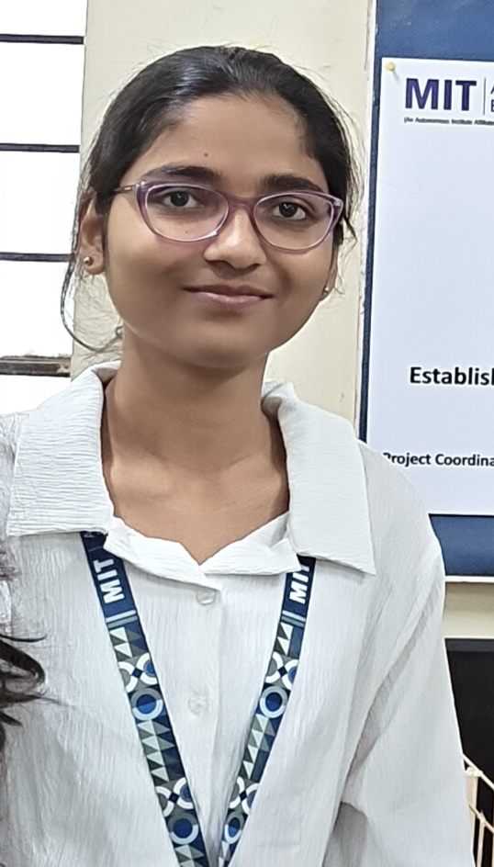
Project Tile – [AI Agent for Smart Farming Advice]
Domain of Project – [ Agriculture]
Student Name | Recent Passport Photo | Email ID | Mobile number [WhatsApp]
DEVYANI VILAS GAWADE |  | devyanig61@gmail.com | 8623902053

Slide 3
Problem Statement -
Problem Statement : AI Agent for Smart Farming Advice
The Challenge
Small-scale farmers often struggle to access reliable and timely agricultural information. They need guidance on crop selection, weather forecasts, soil conditions, pest management, fertilizer usage, and market prices. Existing information is scattered across multiple sources and is often unavailable in local languages, making it difficult for farmers to make informed decisions.
The Objective
Develop an AI-powered Smart Farming Advice Agent using IBM Granite Models, IBM Cloud Lite, and Retrieval-Augmented Generation (RAG) that provides personalized, real-time agricultural assistance.
The solution should:
Recommend suitable crops based on season and soil type.
Provide real-time weather forecasts.
Suggest pest and disease control measures.
Recommend fertilizers and irrigation schedules.
Display current mandi (market) prices.
Support multilingual conversations.
Deliver trusted information using Retrieval-Augmented Generation (RAG).
Multi-Agent System
Crop Recommendation Agent
Weather Advisory Agent
Soil Analysis Agent
Pest & Disease Management Agent
Market Price Information Agent

Slide 4
Proposed Solution -
Proposed Solution – KisanMitra
The proposed solution is an AI-powered farming assistant developed using IBM BOB, IBM Granite Models, and IBM Cloud Lite.
The system enables farmers to ask questions in English, Hindi, or Marathi and receive personalized farming guidance.
The system provides:
Crop Recommendation Agent
Recommends suitable crops based on location, season, and soil conditions.
Weather Advisory Agent
Provides weather forecasts and alerts for farming activities.
Soil & Fertilizer Agent
Recommends fertilizers and nutrient management practices.
Pest Management Agent
Identifies pests and diseases and suggests preventive measures.
Market Price Agent
Retrieves current mandi prices and market trends.
The solution acts as an intelligent digital farming advisor and assists farmers in making data-driven decisions.

Slide 5
Technology Used
IBM BOB
Used to generate the complete full-stack application including frontend, backend, APIs, and deployment files.
IBM Granite Model
Granite-4-h-small
Used for:
Natural Language Understanding
Reasoning
Multilingual Conversations
Agricultural Recommendations
IBM Cloud Lite
Provides secure cloud infrastructure and AI services.
Python Flask
Used for backend APIs and application logic.
HTML5, CSS3 and JavaScript
Used for developing responsive dashboard and chatbot interface.
Retrieval-Augmented Generation (RAG)
Retrieves trusted agricultural information before generating responses.
Vector Database (FAISS)
Stores agricultural knowledge and supports semantic search.

Slide 6
Langflow component Used -
1. Chat Input
Allows farmers to ask questions.
2. IBM watsonx AI Agent
Processes farming queries using Granite.
3. IBM Granite Model
Granite-4-h-small
4. RAG Retriever
Retrieves agricultural information from trusted sources.
5. Vector Database
Stores farming documents and embeddings.
6. Chat Output
Displays farming recommendations.
7. API Components
Weather API
Market Price API
Government Agriculture Data

Slide 7
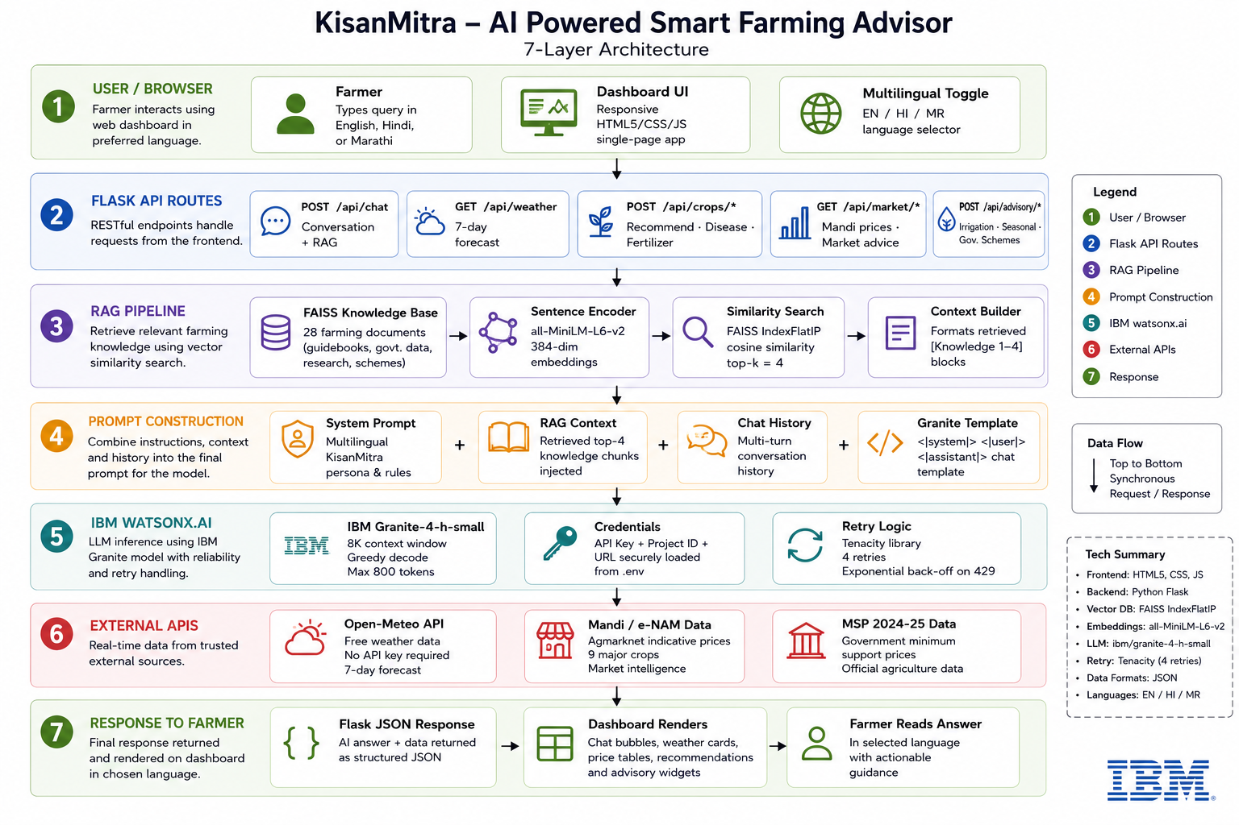
Langflow workflow -

Slide 8
Architecture blueprint

Slide 9

Role of Agentic AI in the solution
Agentic AI enables KisanMitra to function as an intelligent autonomous farming assistant.
Multiple specialized agents collaborate to provide:
Crop recommendations
Weather forecasting
Fertilizer guidance
Pest management
Market intelligence
The agents continuously analyze farmer inputs, retrieve agricultural knowledge, and generate personalized recommendations.
IBM Granite provides reasoning and multilingual understanding, while IBM BOB accelerates full-stack application development.
Overall, Agentic AI makes the system proactive, intelligent, and goal-driven, helping farmers improve productivity and reduce risks.

Slide 10
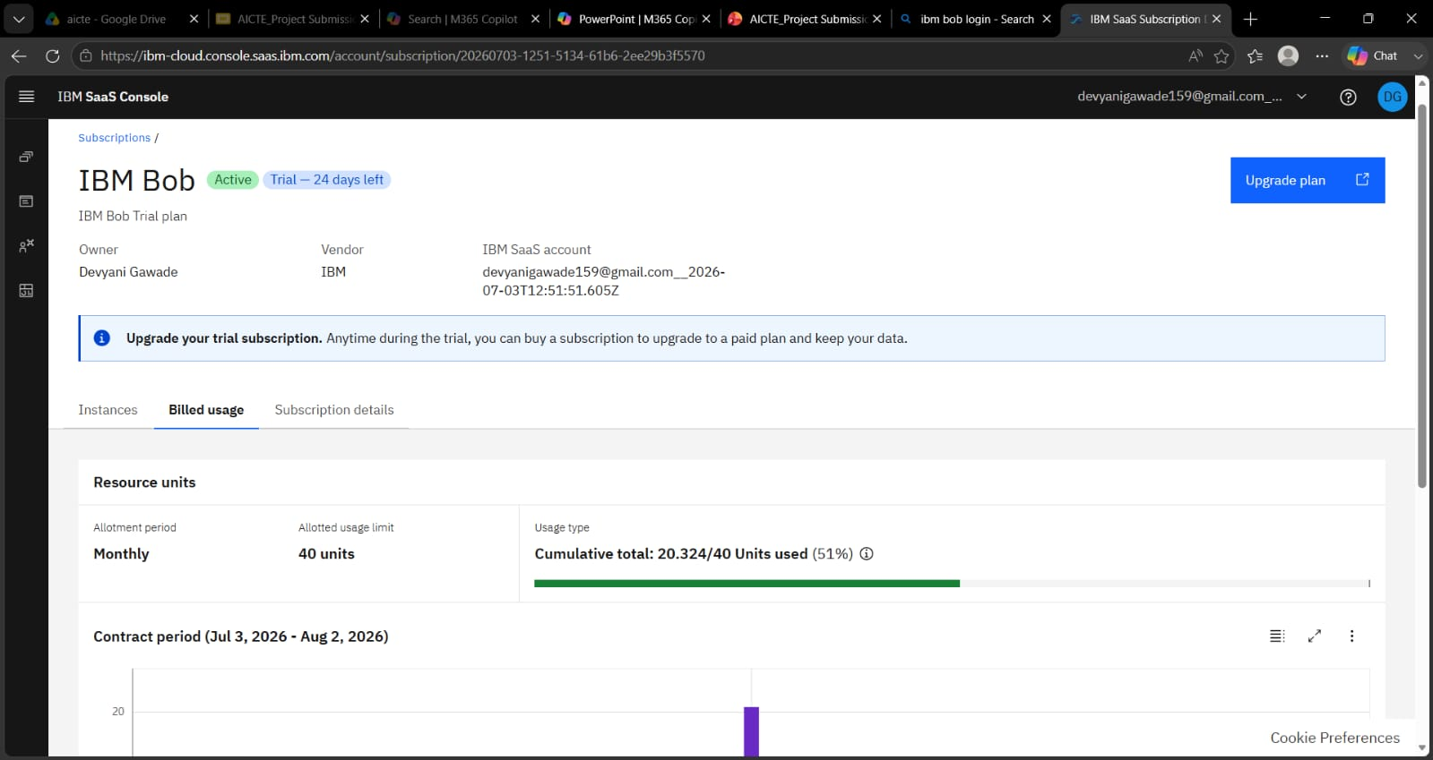
Token Usage
Cumulative total: 20.324/40 Units used (51%)
After the Prompt
·
·
·

Slide 11
Novelty and Uniqueness
AI-Powered Multi-Agent System
Multiple specialized farming agents collaborate.
RAG-Based Agricultural Knowledge
Retrieves trusted information before generating responses.
Real-Time Weather Integration
Provides weather-based farming recommendations.
Market Intelligence
Retrieves live mandi prices.
Multilingual Support
English, Hindi, and Marathi support.
AI-Generated Full-Stack Development
Entire application generated using IBM BOB.
Personalized Farming Guidance
Recommendations based on location, soil, season, and crop.
This makes KisanMitra an intelligent digital farming advisor rather than a simple chatbot.

Slide 12
Git Hub Link
https://github.com/devyanig61-create/Krisan-Mitra-Smart-Farming-AI.git
Please test and Paste the working Github URL –
https://github.com/devyanig61-create/Krisan-Mitra-Smart-Farming-AI.git
Make sure you have Uploaded following three files into your github repository 1) app.json file , 2) yourproblemstatement.pdf file 3) your projectpresntation.pptx file 4)any other files
·
·
·

Slide 13
Future Scope
IoT Sensor Integration for real-time soil monitoring.
Drone-based crop disease detection.
Satellite image analysis for crop health monitoring.
Voice-based farming assistant in regional languages.
AI-based yield prediction.
Smart irrigation automation.
Government subsidy recommendation system.
Integration with precision agriculture technologies.
·
·
·

Slide 14
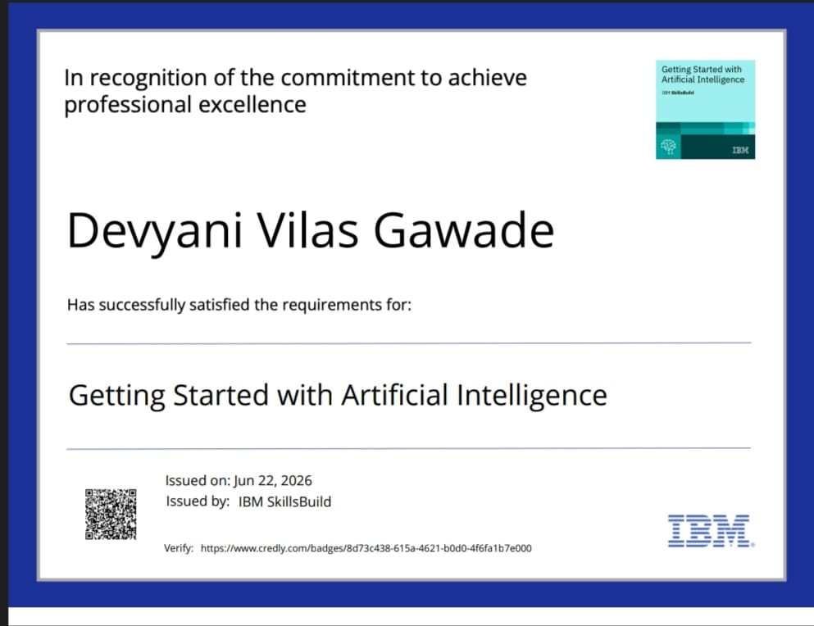
Certificates Earned:

Slide 15
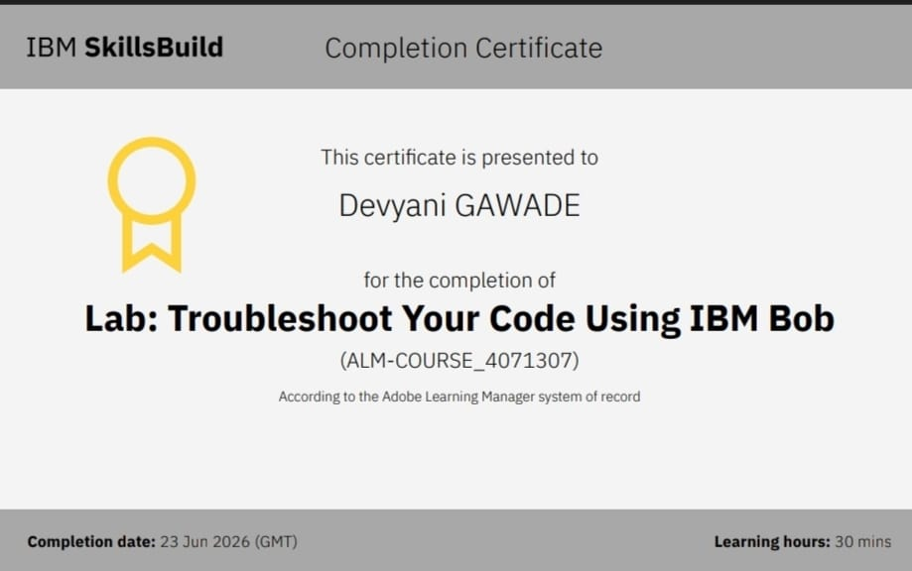
Certificates Earned:​

Slide 16


